Slide 1
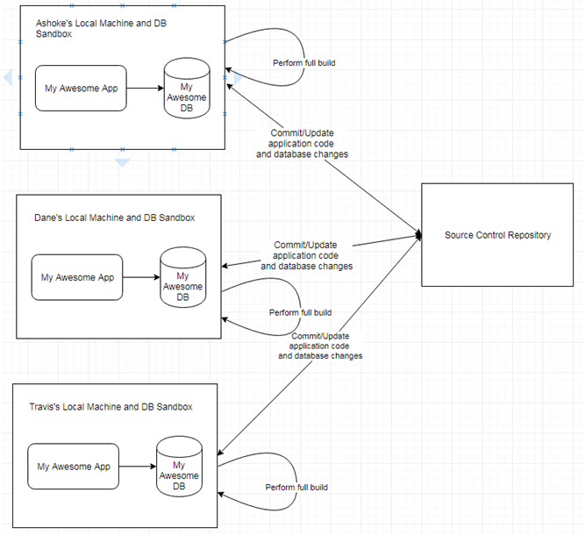
In the given diagram each developer has their own copy of the schema.
When a full build is performed, in addition to building the application, it also builds the database schema from scratch.
It drops the schema, recreates it, and executes DDL scripts to load all schema objects like tables, views, sequences, constraints, and indexes.
It creates objects representing stored code, like functions, procedures, packages, and triggers.
Finally, it loads all the reference data and test data. Automated tests ensure that the application code and database object are always in sync.
It must be noted that data model changes are less frequent than application code, so the build script should have the option to skip the database build for the sake of build performance.

Slide 2
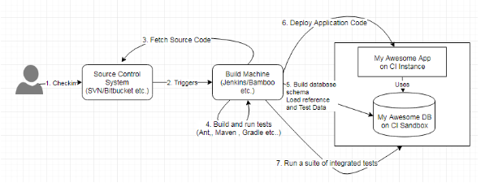
Continuous Integration
The build script performs a full build that includes building the application as well as building the database schema from scratch. It runs a suite of automated tests to ensure that the application itself and the database that it interacts with, are in sync.
The build machine or the CI server contains build job that is triggered by any commit to the repository. The build that it performs includes both the application build and the database build. The database scripts are now always integrated, just like application code.

Slide 3
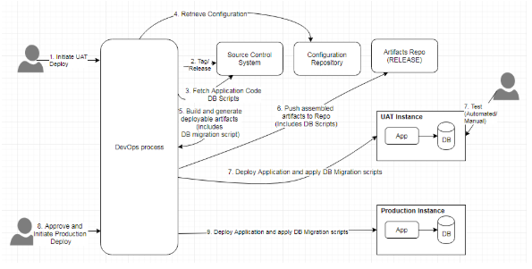
Continuous Delivery

Slide 4
Let us now put the pieces together:
There is a Continuous Integration process which should be in place as shown in earlier slides, that rebuilds the database along with the application code.
You should have a process in place that generates migration scripts for the database. These generated migration scripts are a part of the deployment artifacts.
The DevOps tools will use these released artifacts to build any of the staging environments or the production environment.
The deployment artifacts will also contain rollback scripts to support self-service rollback. If anything goes wrong, the previous version of the application may then be redeployed and the database rollback script shall be run to transition the database schema to the previous state that is in sync with the previous release of the application code.

Slide 5
Lastly, in order to achieve CI/CD in a project that involves database changes which tools are to be used in order to achieve them.
General recommendations of tools are independent of any particular tool.
A homegrown solution can be developed using common automation tools like Maven or Gradle for build automation, Jenkins or TravisCI for Continuous Integration, and Chef or Puppet for configuration management.
However, there are many tools available in the marketplace, that specifically deal with Database DevOps.
Those tools may also be taken advantage of. Some examples are:
Datical
Redgate
Liquibase
Flyway

